Slide 1
Transcriptomic response to Netrin-1
in primary rat cortical neurons
Bulk RNA-seq across DIV1, DIV2 and DIV2 + Netrin-1
25
1,495
3 conditions x 3 biological replicates | 24 h Netrin-1 treatment | DESeq2 + GSEA/ORA
strict Netrin-responsive DEGs
strict DIV2 vs DIV1 DEGs

Slide 2
ORIENTATION
The talk has one question and three evidence layers.
Question
What does Netrin-1 do to the transcriptome after 24 h, and which signals are likely neuronal versus glial?
01
Single-gene differential expression
02
Gene-set programs
03
Cell-type attribution
DEGs and top marker genes
GSEA/ORA resolves coordinated biology
Marker panels and receptor expression constrain interpretation
02
Netrin-1 RNA-seq | primary rat cortical cultures | June 2026

Slide 3
BIOLOGY
Netrin-1 is known for guidance; the transcriptional program is the open question.
Canonical axon-guidance cue acting through DCC, UNC5, Neogenin and DSCAM-family receptors.
Known
Acute growth-cone steering and local translation are well established.
directional guidance, local translation, receptor-mediated signaling
A 24 h bulk RNA-seq response can reveal slower programs, but mixed cultures demand careful cell-source attribution.
Unknown
whether the 24 h response is neuronal, glial, immune-like, or a mixture
03
Netrin-1 RNA-seq | primary rat cortical cultures | June 2026

Slide 4
DESIGN
The design separates treatment response from the larger DIV1-to-DIV2 transition.
DIV1
DIV2
DIV2 + Netrin-1
n = 3 biological replicates
n = 3 biological replicates
n = 3 biological replicates
Primary contrast
Context contrast
C1: DIV2 + Netrin-1 vs DIV2
C2: DIV2 vs DIV1
Treatment effect
24 h developmental change
DESeq2 model: ~ batch + condition
Strict DEGs: padj < 0.05 and |log2FC| > 0.585
GSEA: Wald-ranked genes, minGSSize = 15, nPermSimple = 10,000
04
Netrin-1 RNA-seq | primary rat cortical cultures | June 2026

Slide 5
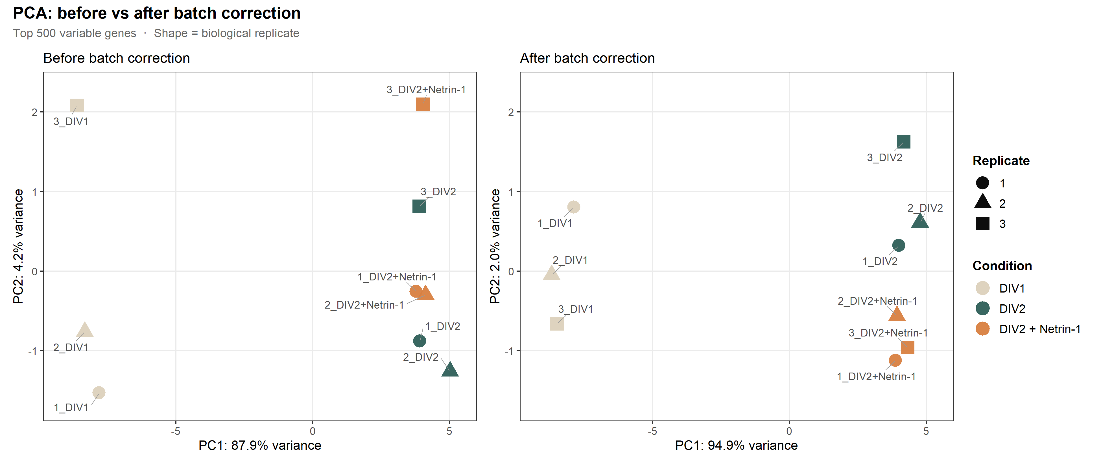
QUALITY CONTROL
The sequencing data are clean enough for contrast-level interpretation.
0.986-0.999
9-10
sample correlation range
RIN range; mean 9.9
34.2-52.3M
16,451-17,093
read pairs per sample
detected genes per sample
Batch correction was used for display only; statistical testing retained the DESeq2 batch term.
05
Netrin-1 RNA-seq | primary rat cortical cultures | June 2026

Slide 6
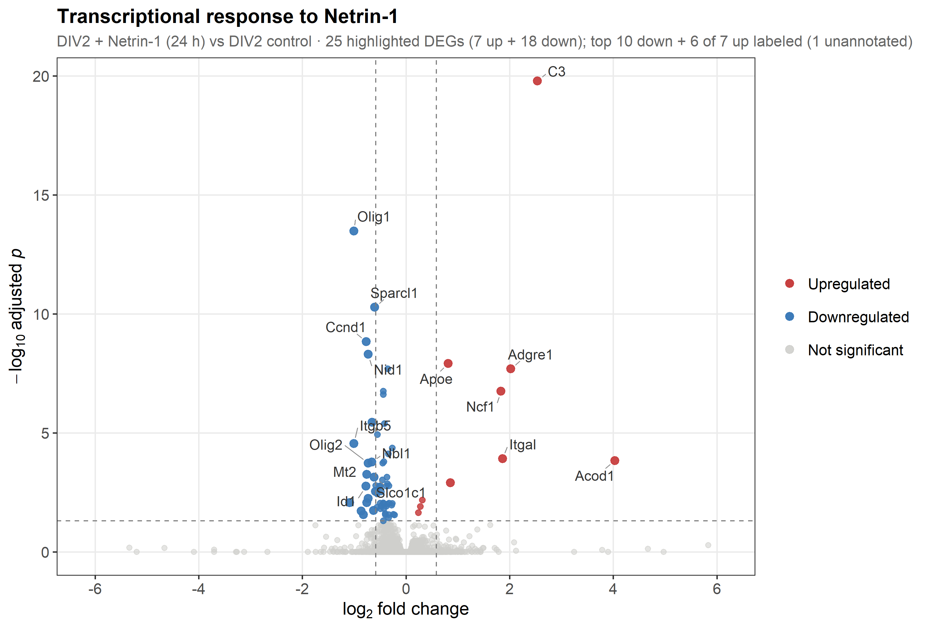
CONTRAST 1
Netrin-1 elicits a focused bidirectional response, not a wholesale transcriptome shift.
25
strict DEGs: 7 up + 18 down
66
relaxed DEGs: 10 up + 56 down
Up: C3, Apoe, Adgre1, Ncf1, Itgal, Acod1.
Down: Olig1, Olig2, Ccnd1, Sparcl1 and related progenitor/glial markers.
The response is small in DEG count, but coherent in biology.
06
Netrin-1 RNA-seq | primary rat cortical cultures | June 2026

Slide 7
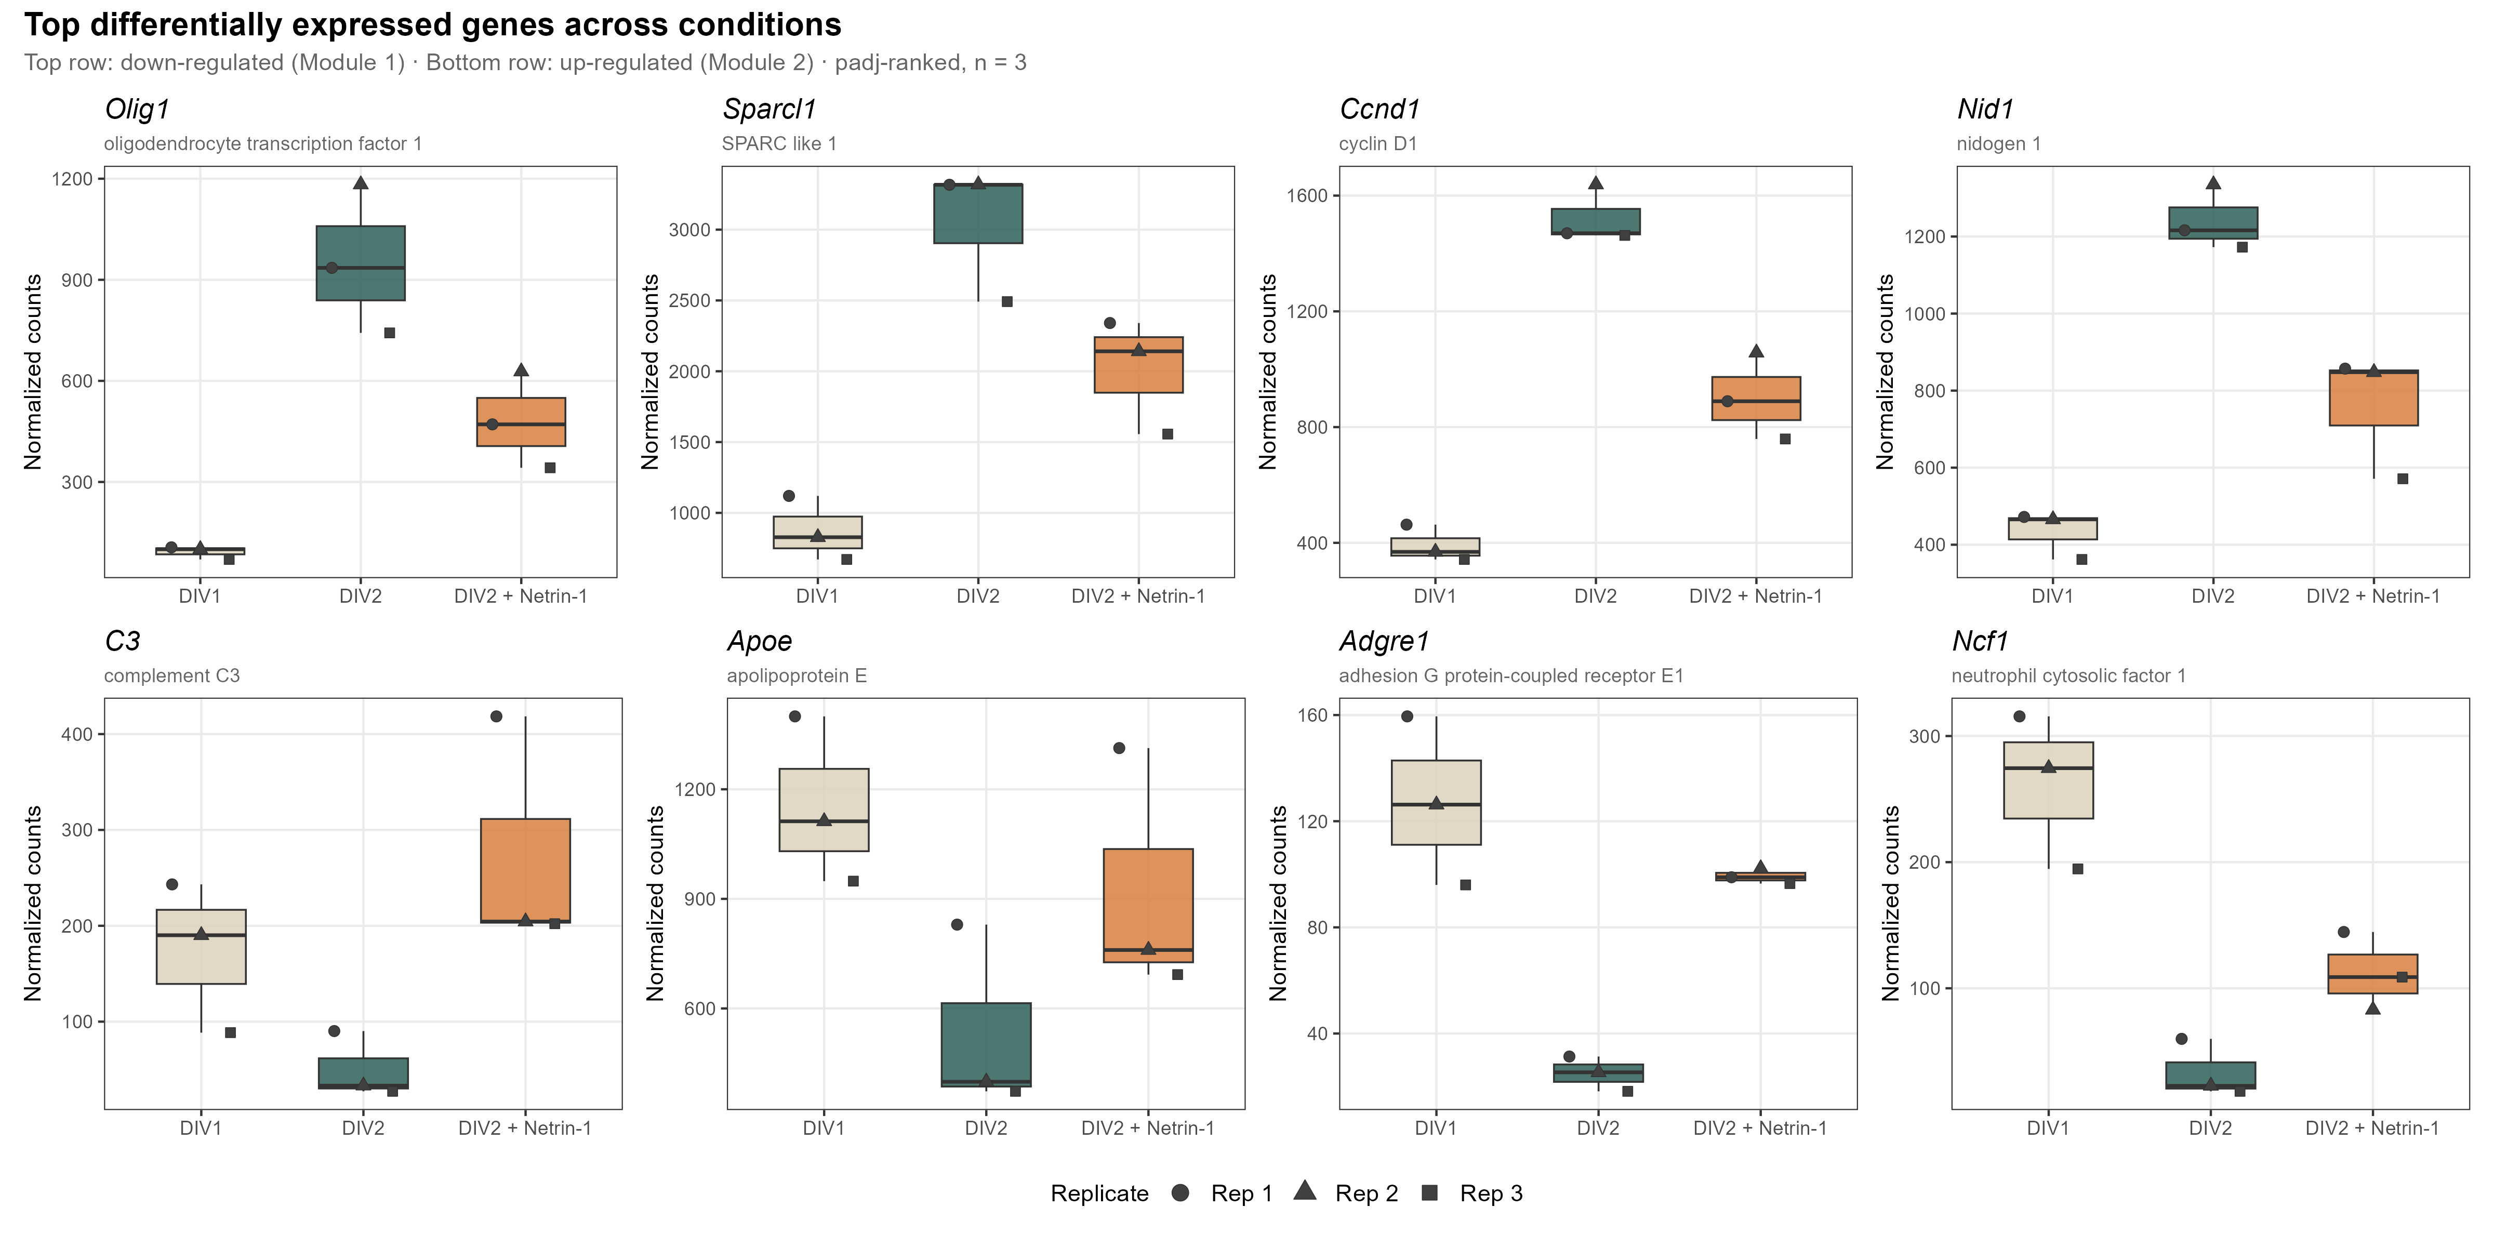
SINGLE GENES
The strongest individual DEGs point to immune/glial and progenitor modules.
Module read
Immune-like genes rise, while oligodendrocyte/progenitor genes fall.
C3 is the most significant up-regulated gene.
Olig1 is the most significant down-regulated gene.
The single-gene signal alone is not enough to claim a neuron-intrinsic program.
07
Netrin-1 RNA-seq | primary rat cortical cultures | June 2026

Slide 8
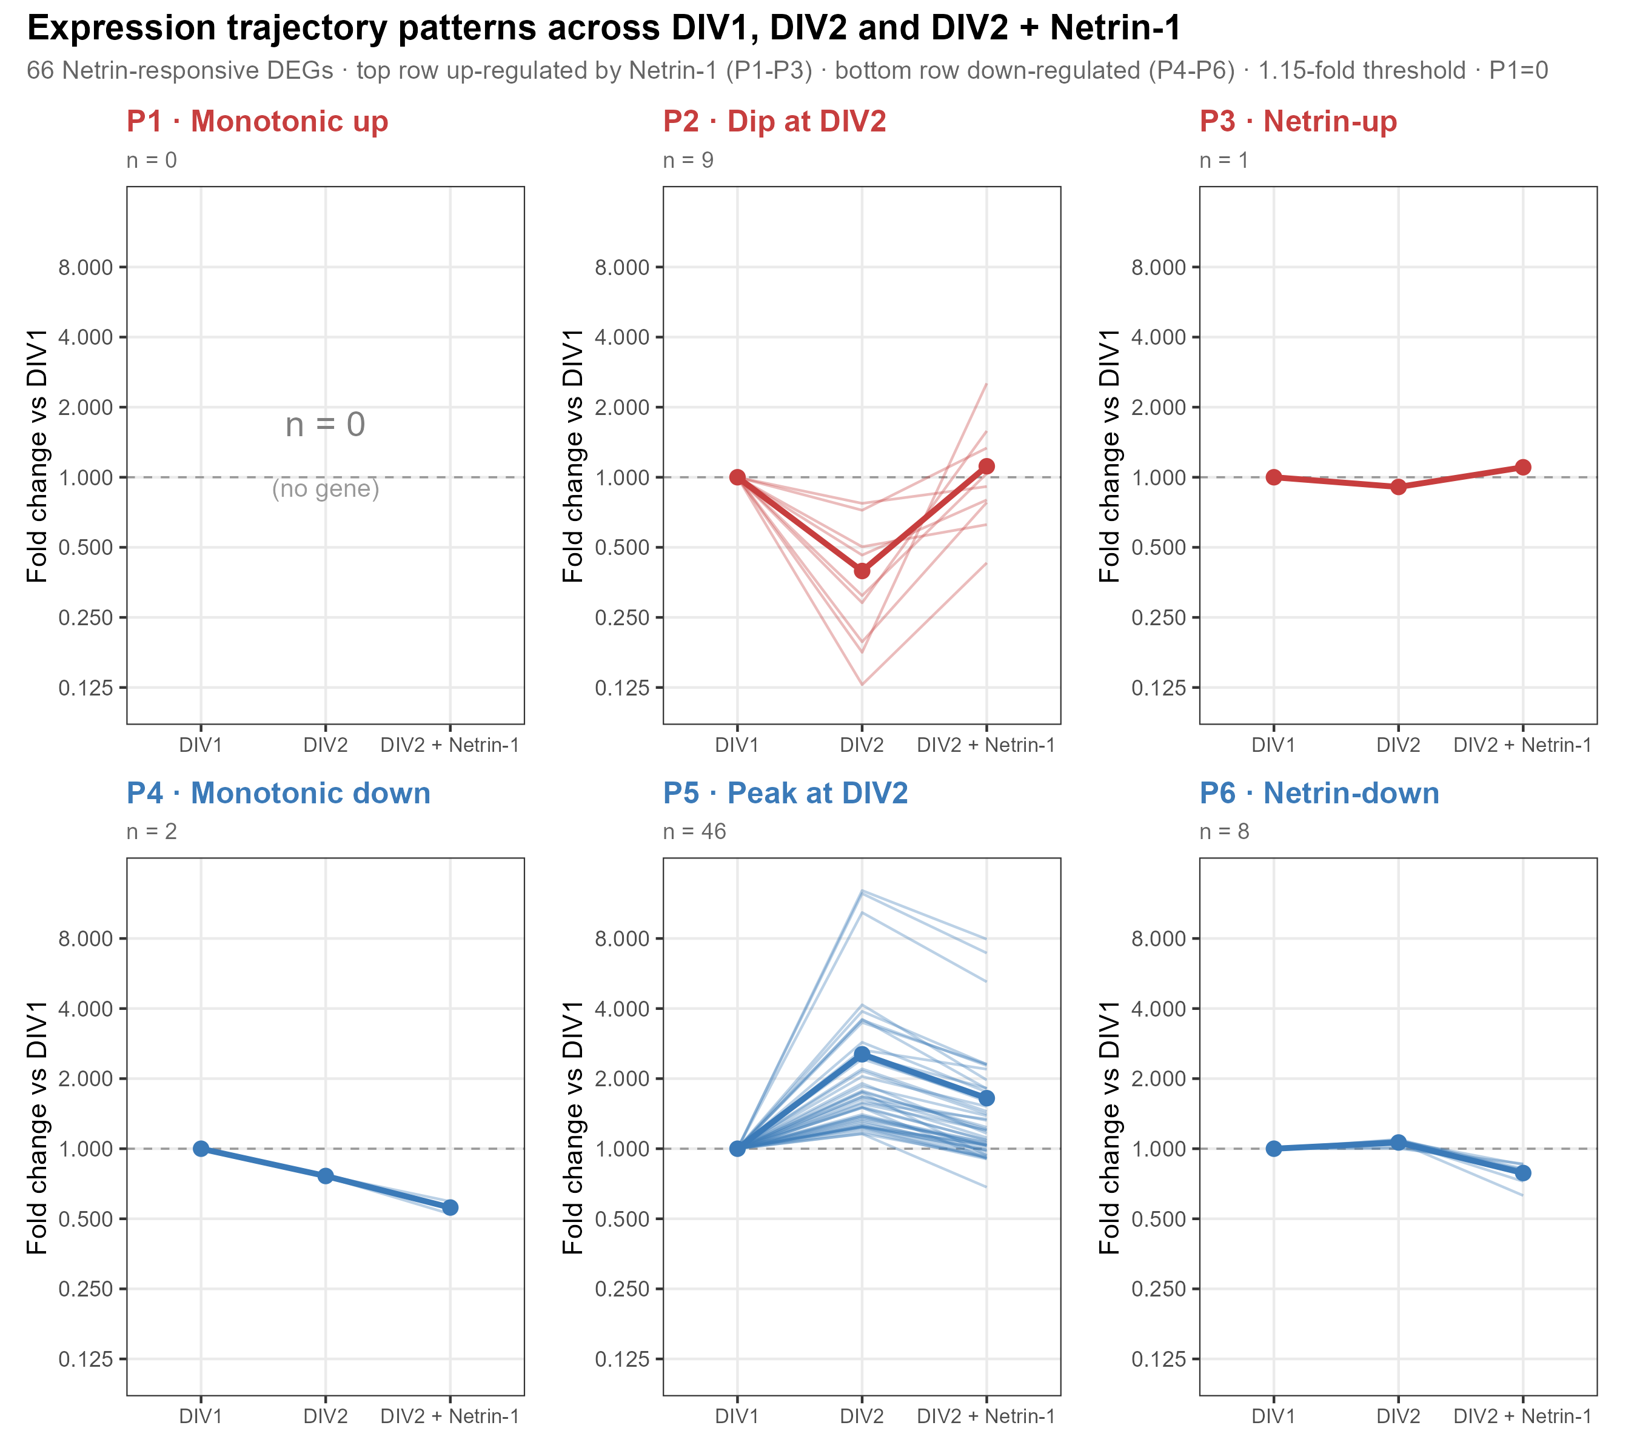
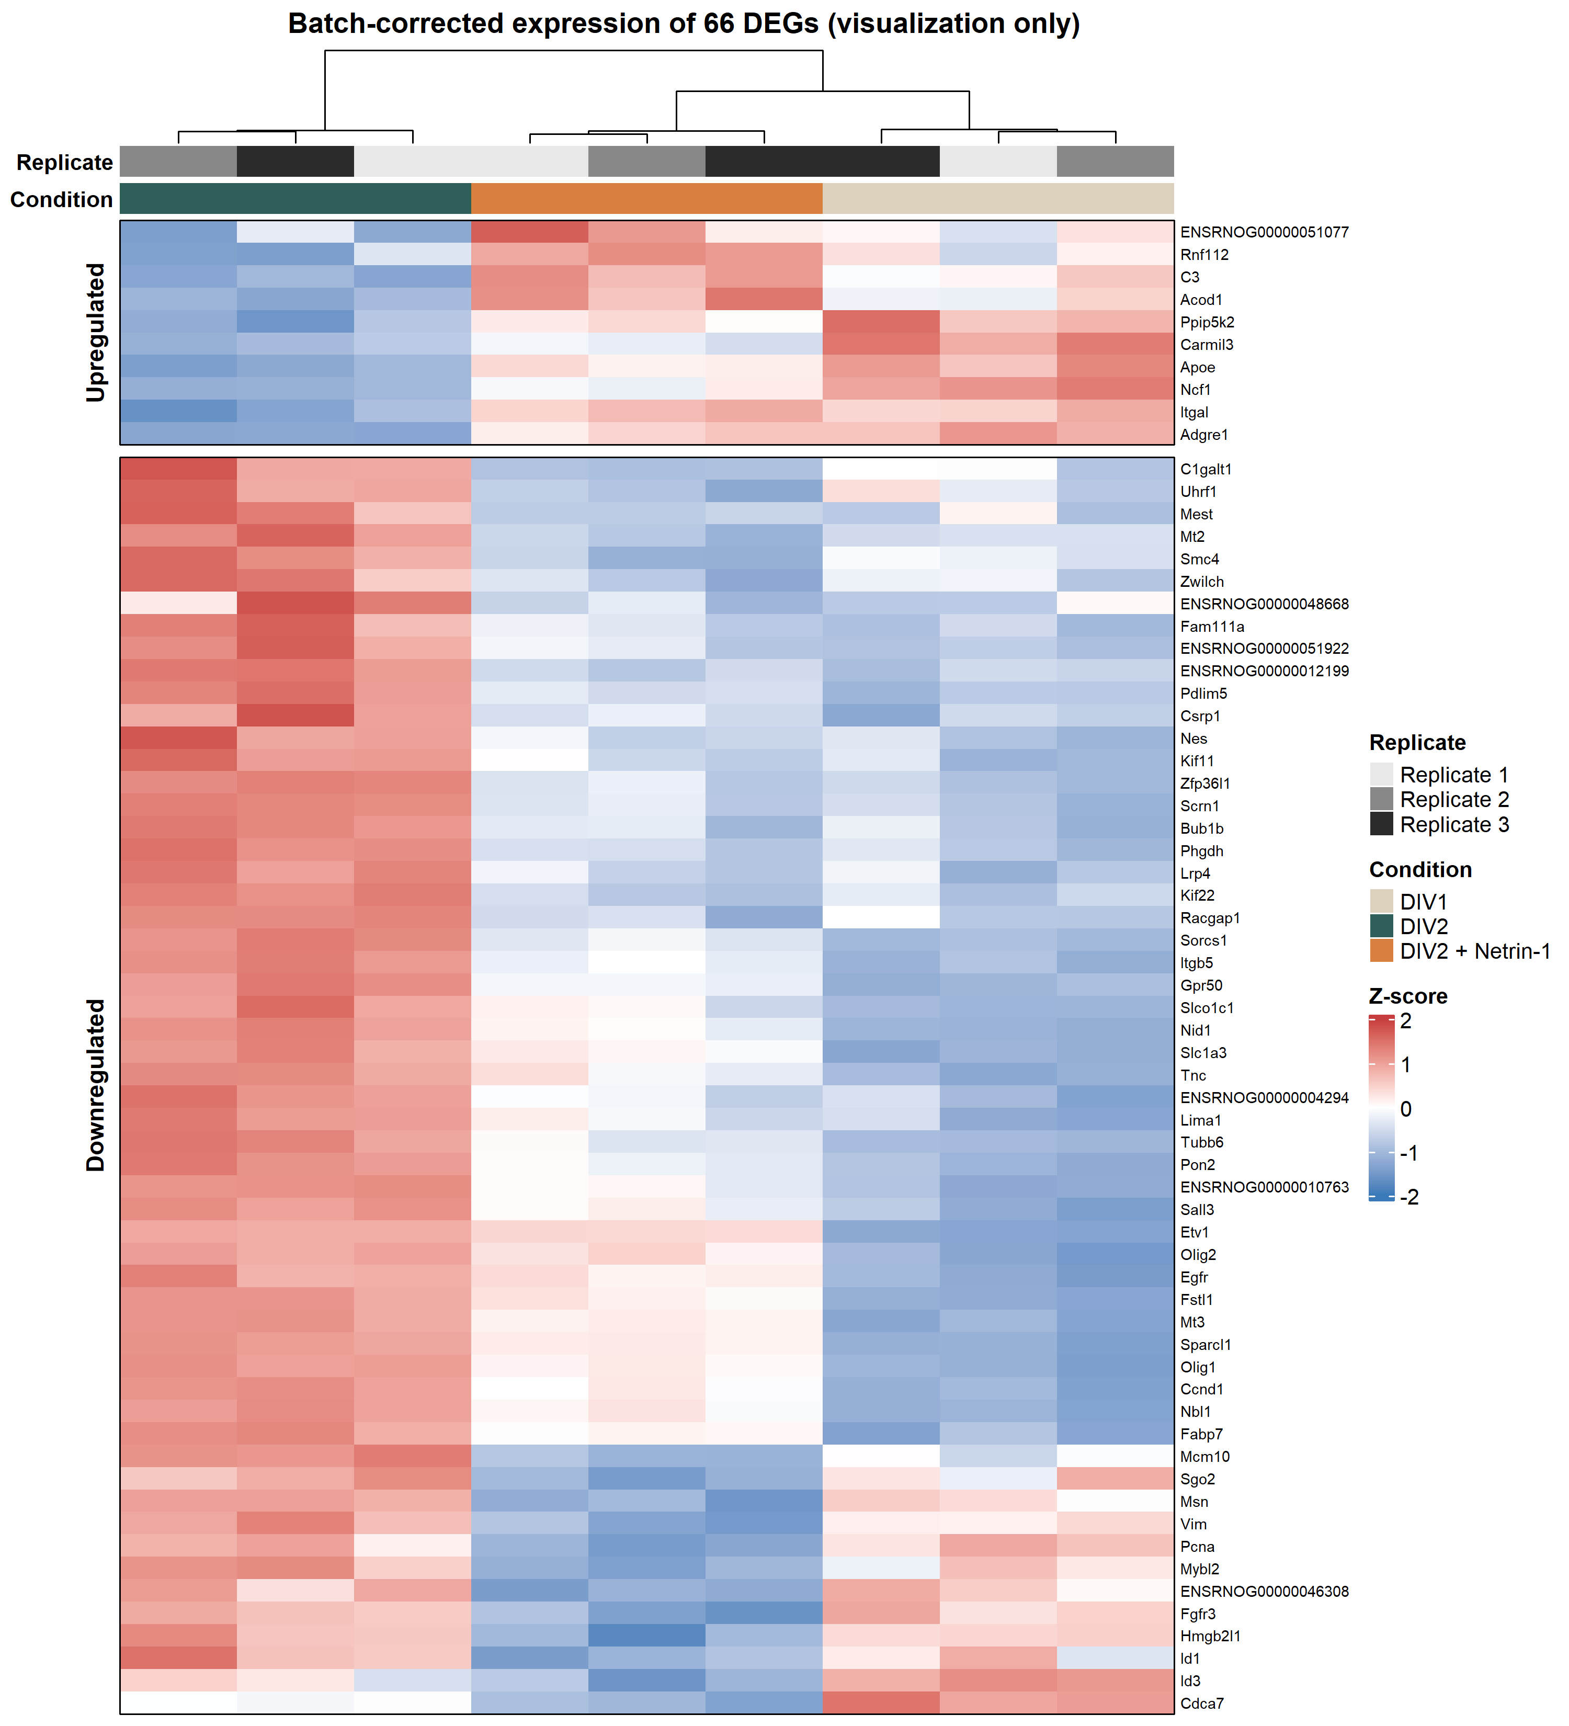
EXPRESSION PATTERN
The 66 relaxed DEGs organize into interpretable trajectories across DIV1, DIV2 and Netrin.
08
Netrin-1 RNA-seq | primary rat cortical cultures | June 2026

Slide 9
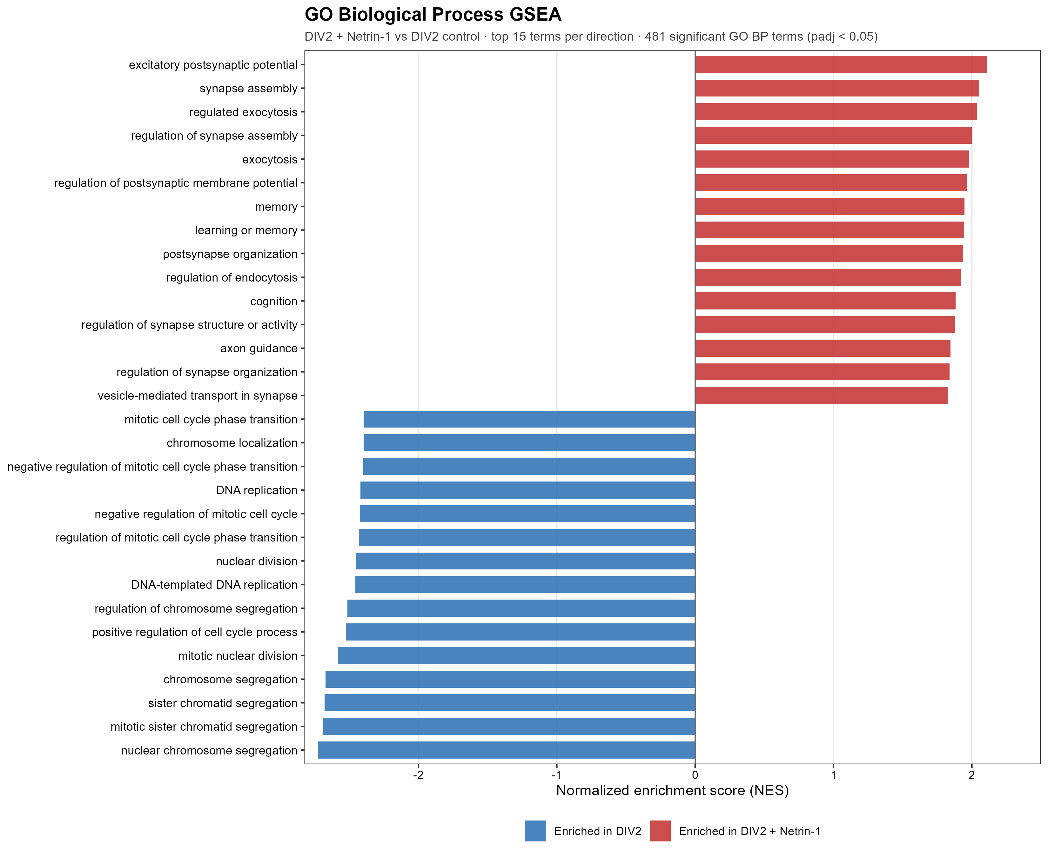
GENE SETS
GSEA reveals the neuronal signal that single-gene DEG lists understate.
481
GO BP terms significant
255 / 226
activated / suppressed
Activated: excitatory postsynaptic potential, synapse assembly, exocytosis, learning/memory.
Suppressed: chromosome segregation, DNA replication and cell-cycle programs.
09
Netrin-1 RNA-seq | primary rat cortical cultures | June 2026

Slide 10
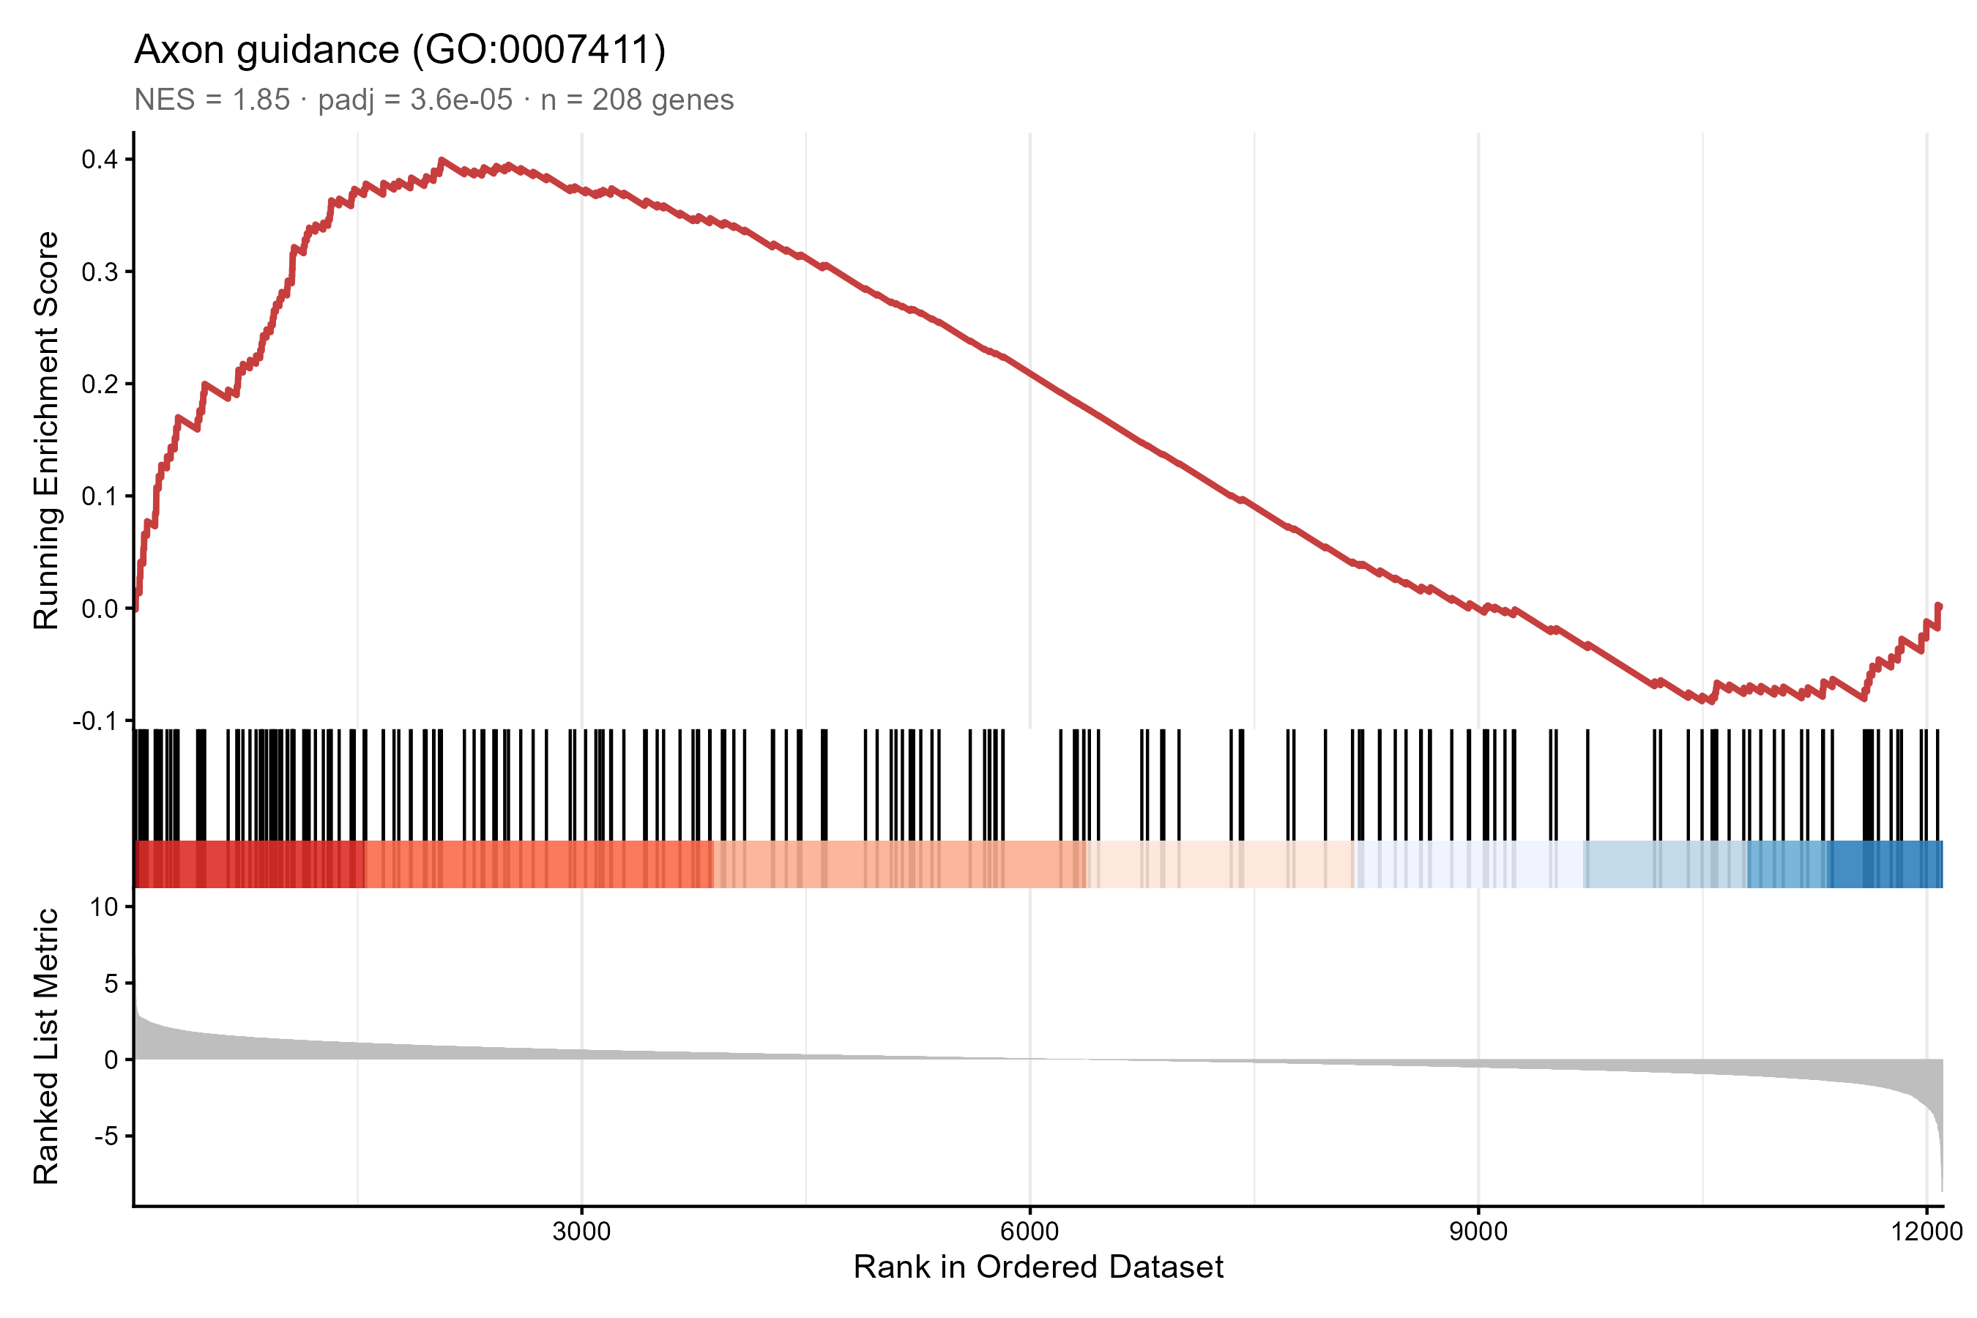
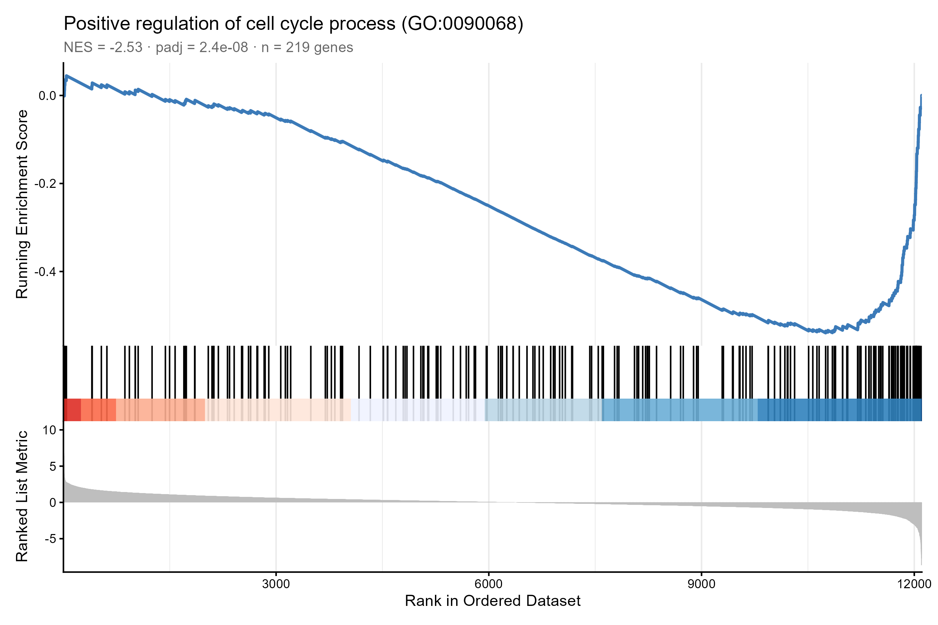
PATHWAY DETAIL
Axon guidance is activated while cell-cycle machinery is suppressed.
Axon guidance: GO BP NES +1.85, padj 3.6e-5; KEGG NES +1.72, padj 0.0024.
KEGG Cell cycle: NES -2.70, padj 1.7e-8.
10
Netrin-1 RNA-seq | primary rat cortical cultures | June 2026

Slide 11
CONTRAST 1 SYNTHESIS
Netrin-1 looks like two linked modules: neuronal tuning plus glial/immune response.
Module A: neuronal
Module B: immune/glial
synapse assembly, axon guidance, exocytosis; coordinated at gene-set level
C3, Apoe, Adgre1, Ncf1, Acod1; strong single-gene signature
Suppressed program
cell cycle and progenitor/oligodendrocyte-associated markers
The honest interpretation: direct neuronal receptor signaling is likely, but immune genes are best treated as secondary or cell-type-linked until validated.
11
Netrin-1 RNA-seq | primary rat cortical cultures | June 2026

Slide 12
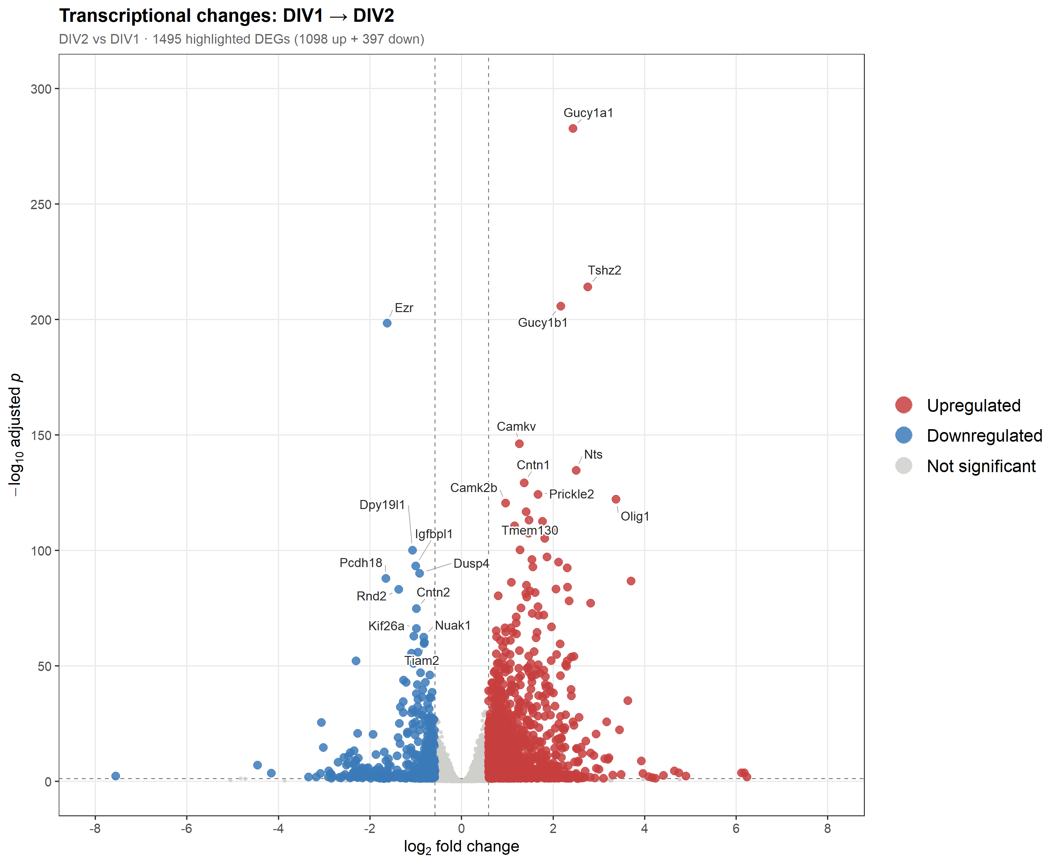
CONTRAST 2
DIV1-to-DIV2 development is much larger than the Netrin treatment effect.
1,495
strict DEGs: 1,098 up + 397 down
4,636
relaxed DEGs: 2,603 up + 2,033 down
Olig1 reverses direction: up during DIV2 development, down after Netrin treatment.
12
Netrin-1 RNA-seq | primary rat cortical cultures | June 2026

Slide 13
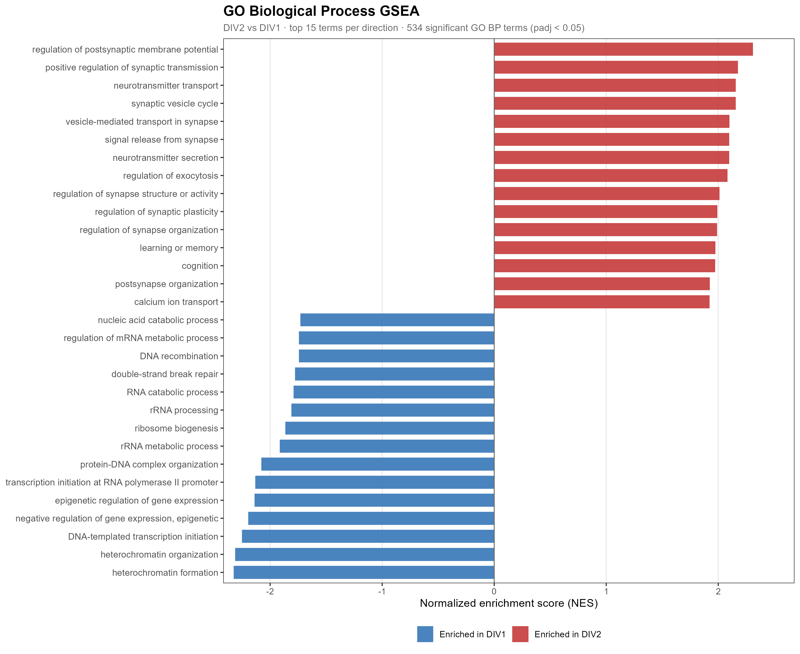
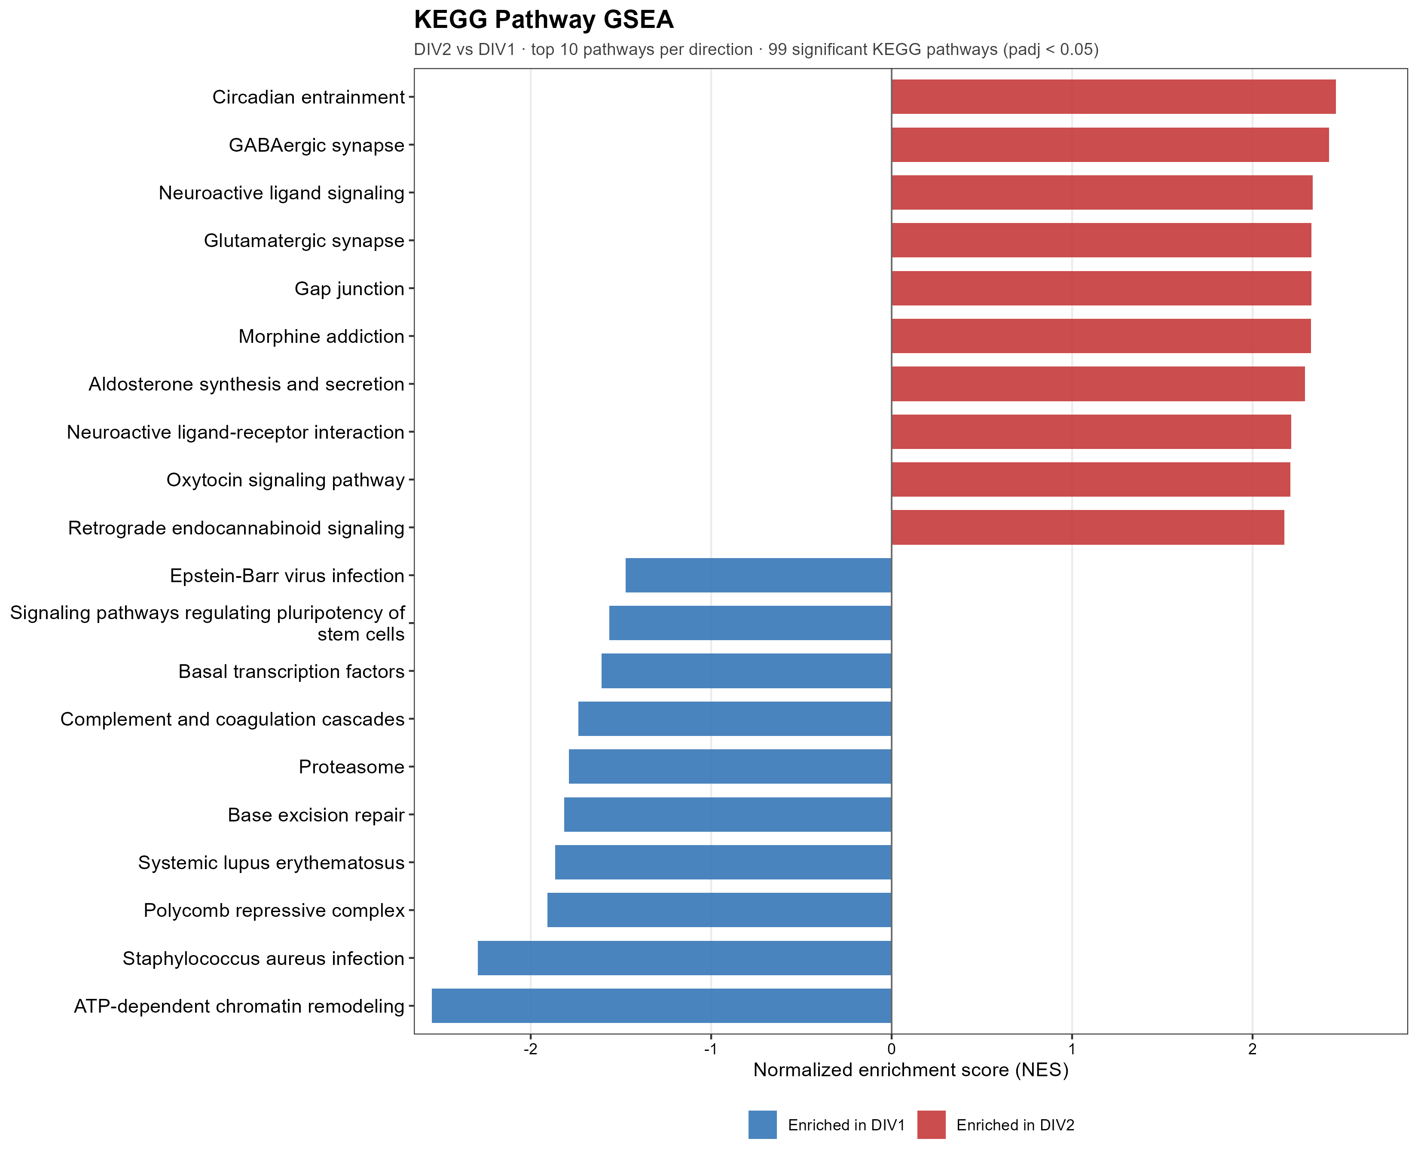
DEVELOPMENTAL CONTEXT
Development opens neuronal maturation programs en masse.
DIV2-enriched: synaptic transmission, neurotransmitter transport, plasticity, GABAergic/glutamatergic synapse.
13
Netrin-1 RNA-seq | primary rat cortical cultures | June 2026

Slide 14
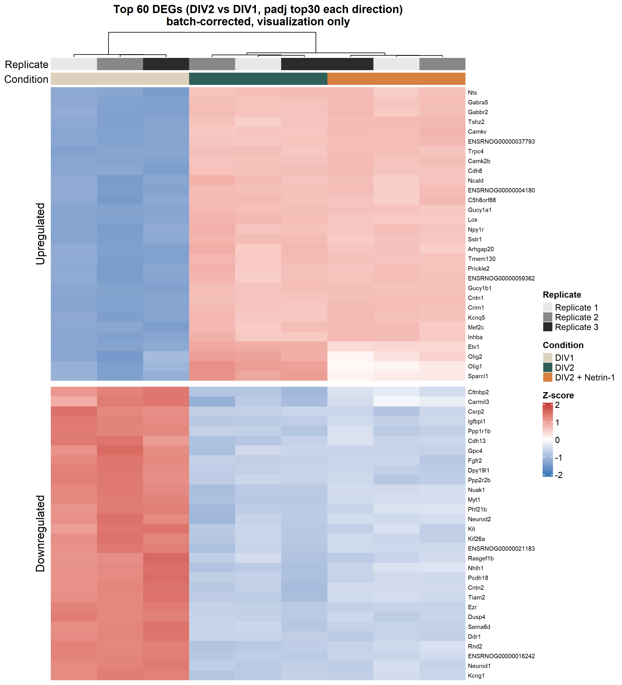
EXPRESSION STRUCTURE
C2 heatmaps show development dominating sample structure.
DIV1 separates strongly from DIV2 and DIV2 + Netrin.
This contrast is a context anchor rather than the main treatment conclusion.
The size of C2 helps calibrate how focused the C1 response is.
14
Netrin-1 RNA-seq | primary rat cortical cultures | June 2026

Slide 15
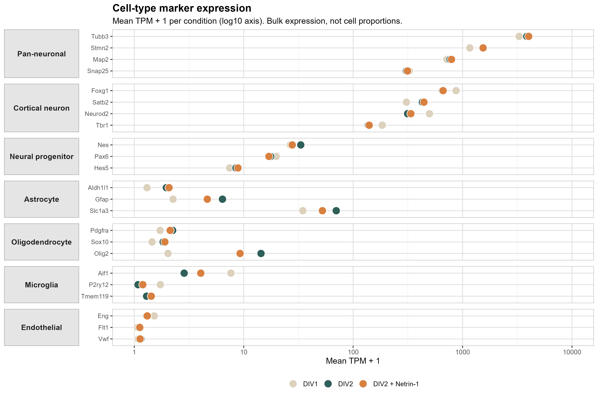
CULTURE CONTEXT
Bulk RNA-seq requires cell-type caution before assigning mechanism.
The cultures are neuron-rich but not neuron-only.
No AraC means glial populations can contribute to bulk signal.
Marker behavior is used to constrain, not prove, cell-of-origin.
This is why C1 single genes and C1 GSEA are interpreted separately.
15
Netrin-1 RNA-seq | primary rat cortical cultures | June 2026

Slide 16
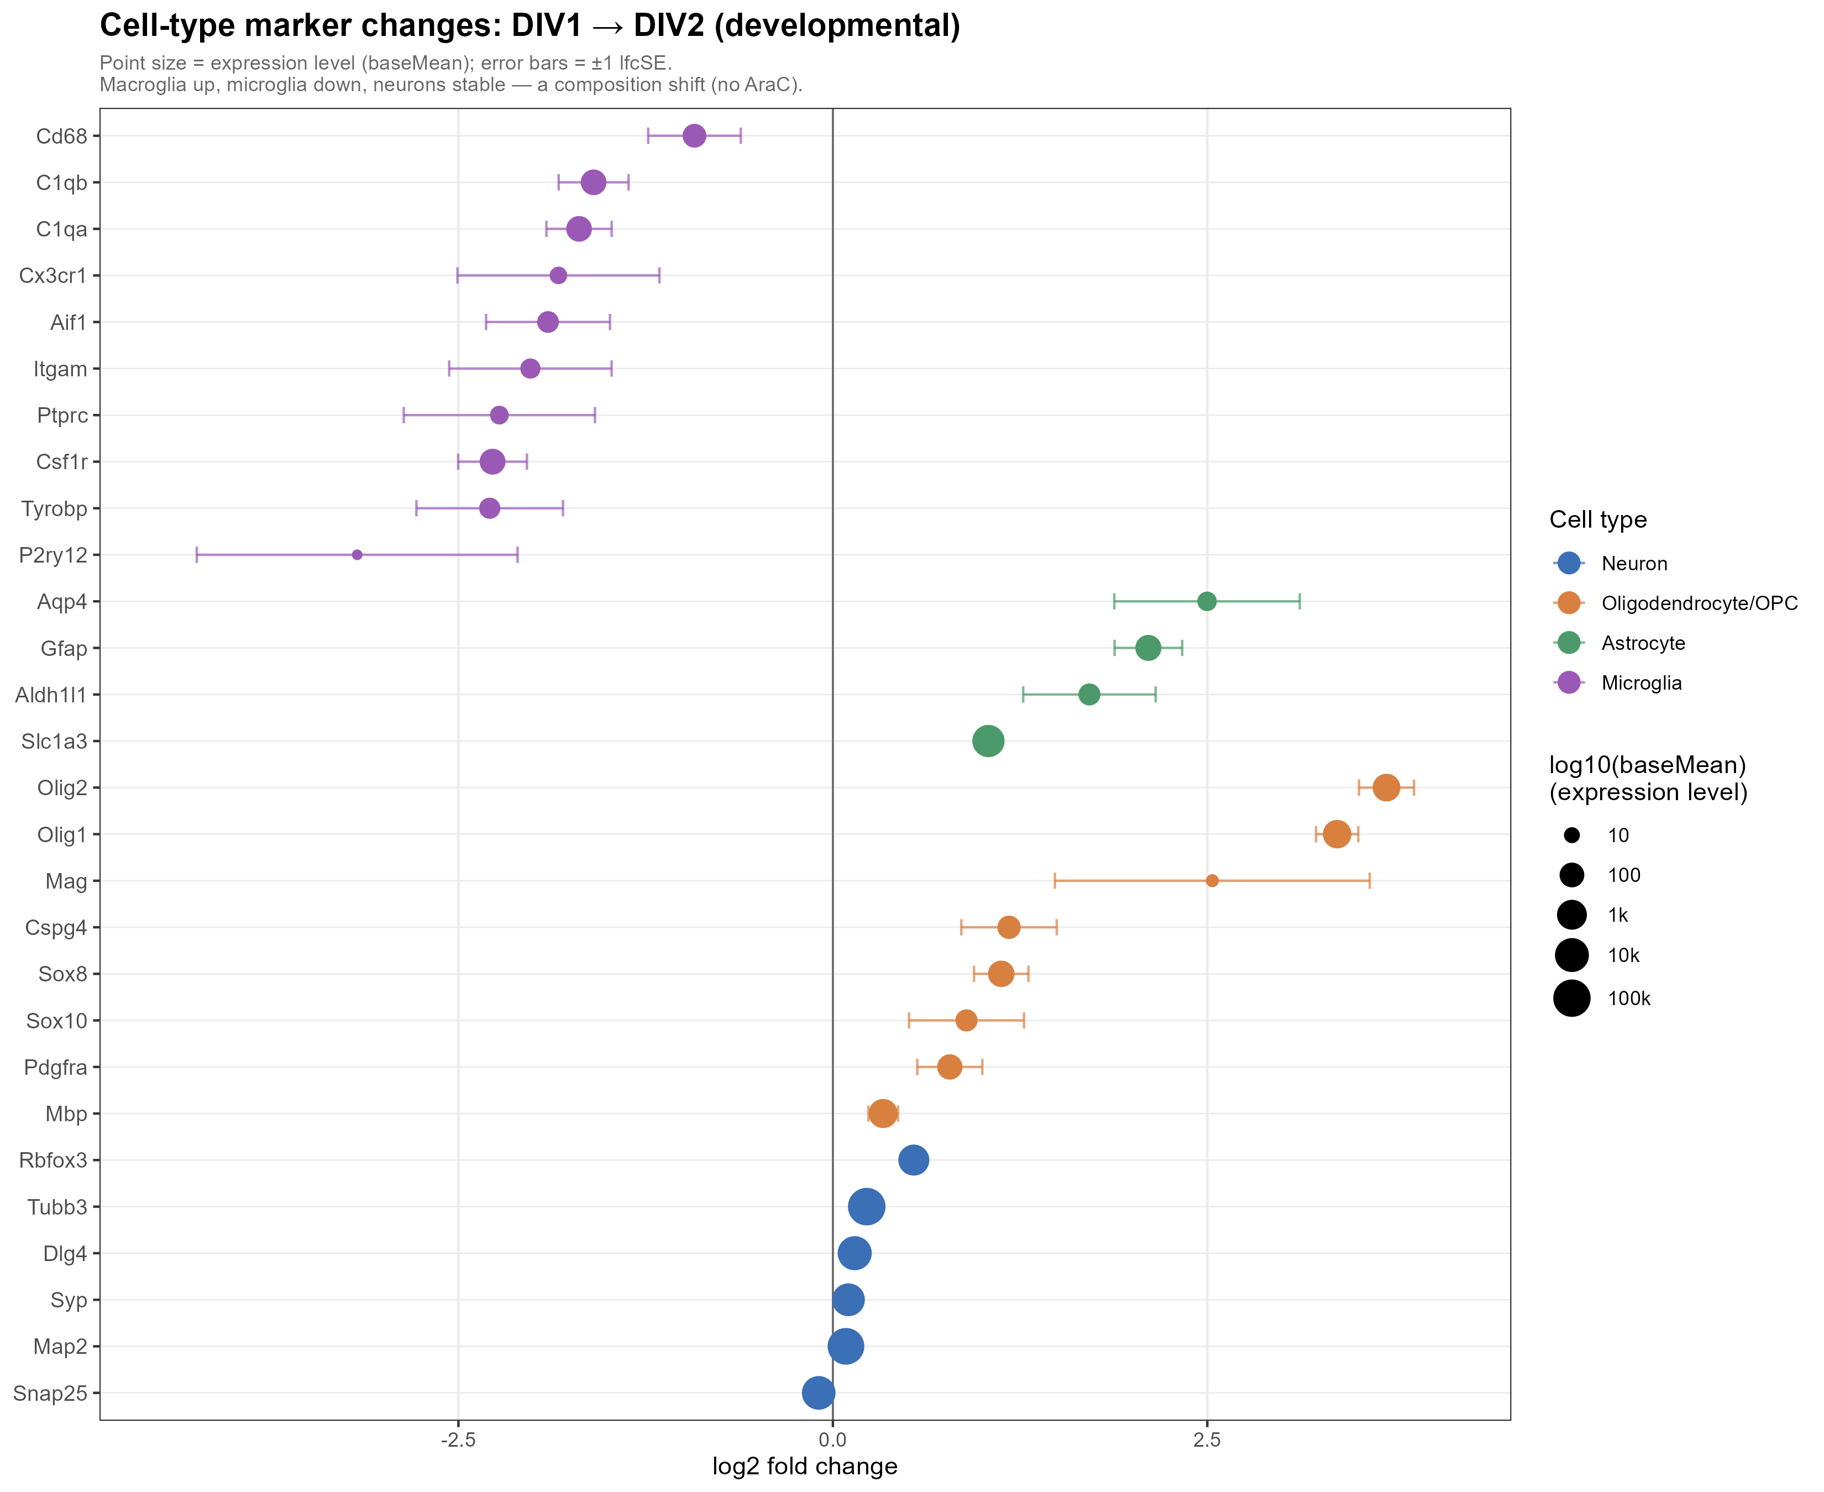
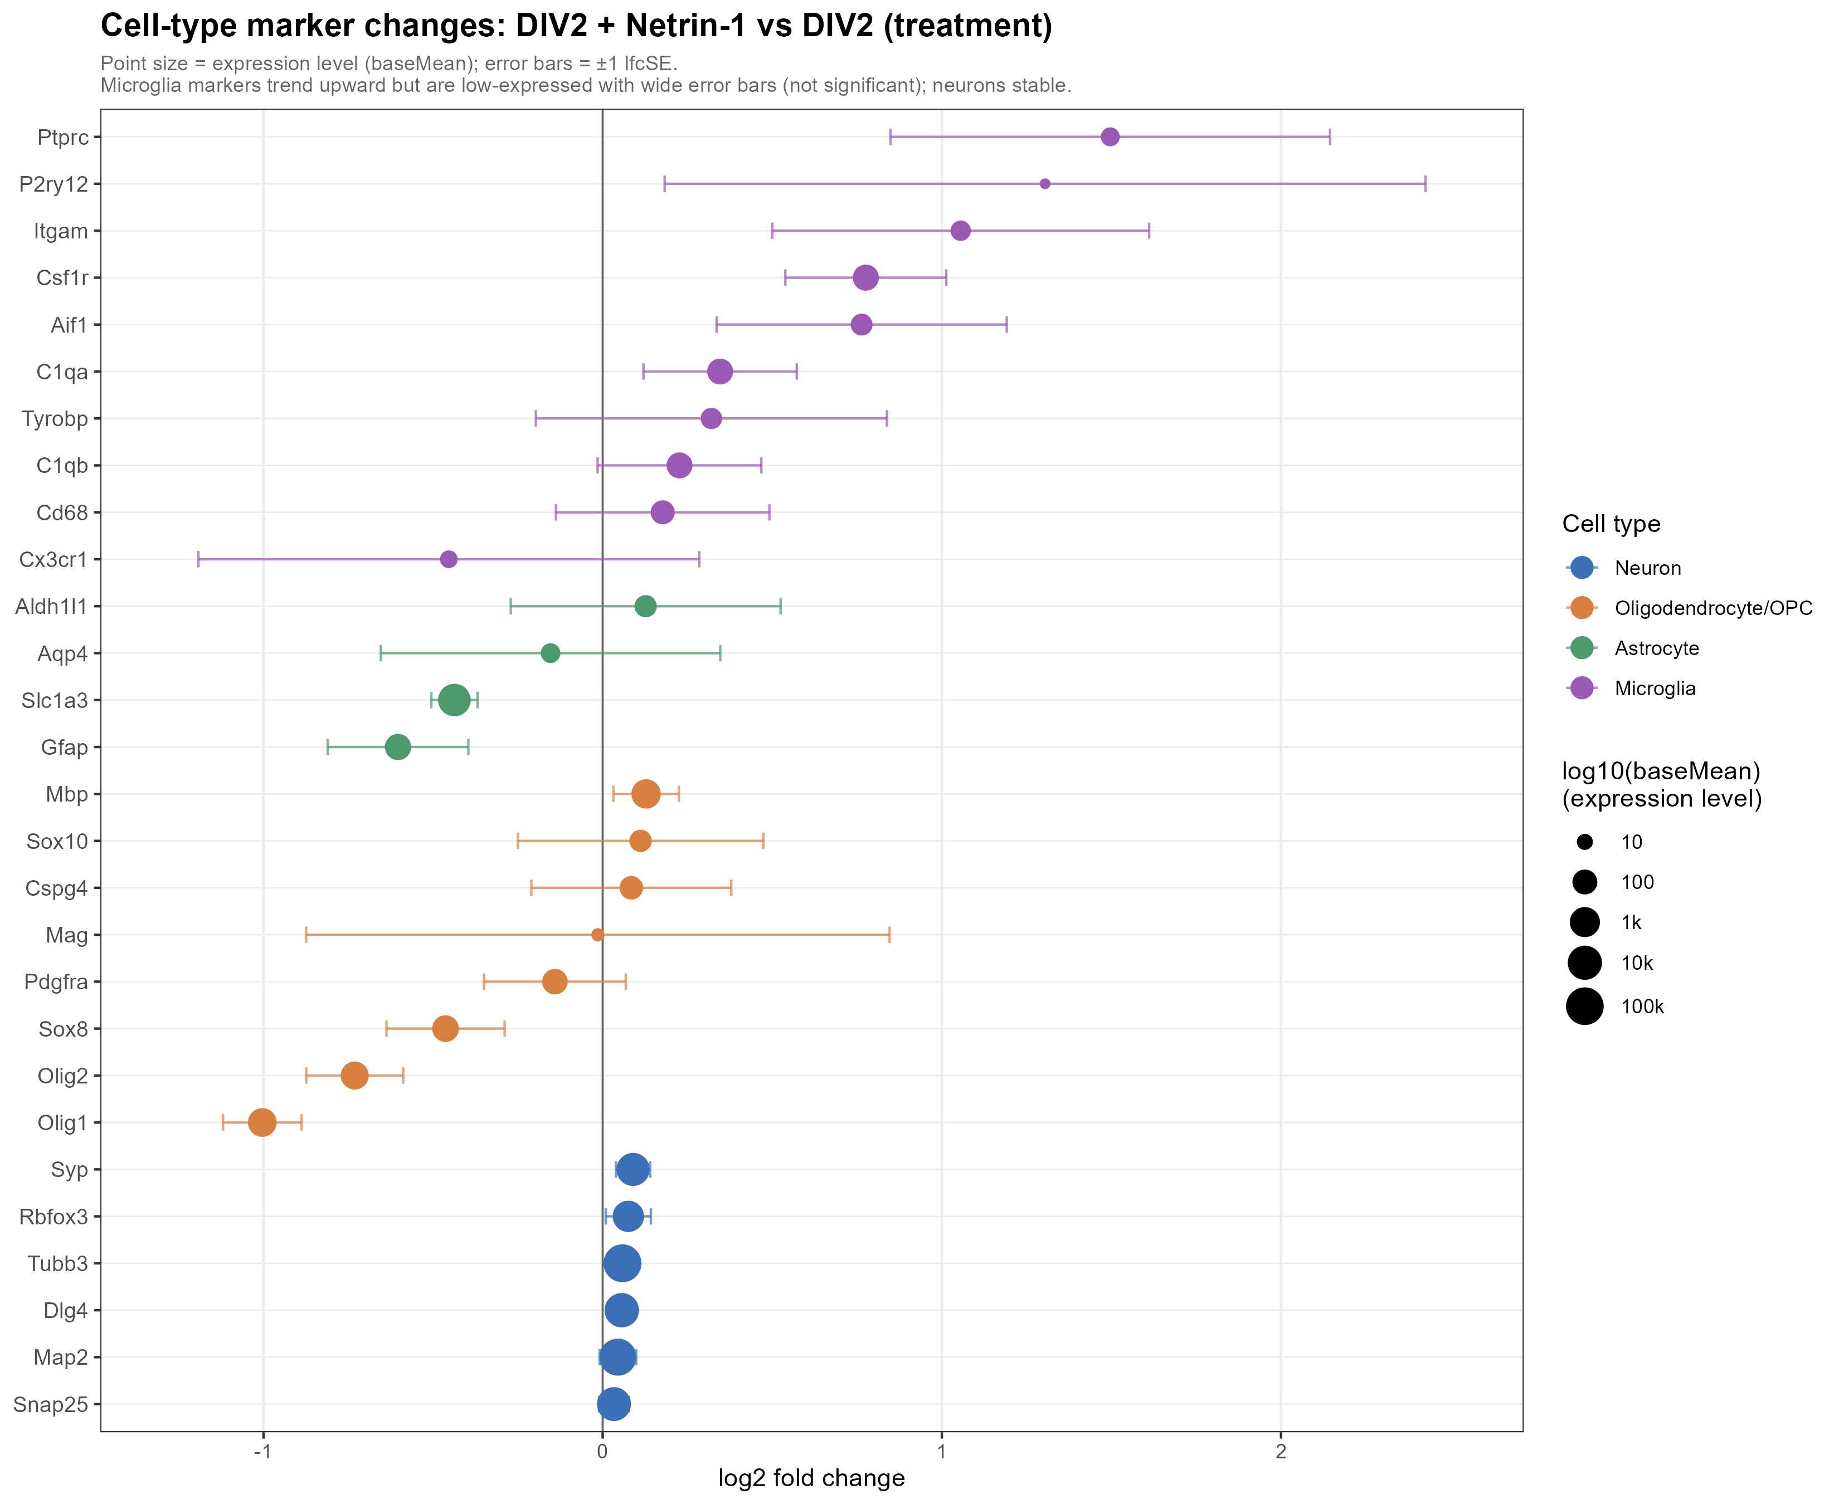
CELL-TYPE MARKERS
Development shifts composition; Netrin treatment does not show a matching composition shift.
C2: macroglia/OPC/astrocyte markers rise and microglia markers fall.
C1: microglial markers trend upward, but broad composition is comparatively stable.
16
Netrin-1 RNA-seq | primary rat cortical cultures | June 2026

Slide 17
DIRECT TARGET
Netrin receptors are abundant, while endogenous Ntn1 is near background.
baseMean expression
Median expressed gene baseMean = 705
Interpretation
Neo1
9413
Neurons have the receptor machinery to respond directly; receptor levels do not need to change for pathway activation.
Dcc
3102
Dscam
1936
Unc5a
1591
Unc5d
1210
The immune module therefore remains biologically real but mechanistically indirect until cell-type-specific validation.
Unc5c
427
Unc5b
166
Ntn1 ligand
10.6
17
Netrin-1 RNA-seq | primary rat cortical cultures | June 2026

Slide 18
WORKING MODEL
Netrin likely acts directly on neurons, with a secondary immune/glial transcriptional echo.
Cortical neurons
Axon guidance + synapse
Neo1 / Dcc / Dscam / Unc5 receptors abundant
reliable neuronal program; GSEA-level signal
Exogenous Netrin-1
near-zero endogenous Ntn1 background
Microglia / glia
C3 / Apoe / Adgre1 / Ncf1 immune module
Use careful language: consistent with microglial activation, not proof that Netrin directly activates microglia.
18
Netrin-1 RNA-seq | primary rat cortical cultures | June 2026

Slide 19
C1 VS C2
Netrin fine-tunes both directions; development is activation-skewed.
GSEA GO BP significant terms
DEG scale
C1 activated
C1 strict DEGs
255
25
C1 suppressed
C2 strict DEGs
226
1,495
C2 activated
410
Key message
C2 suppressed
The treatment contrast is not a mini-version of development. It is a focused bidirectional perturbation laid on top of a rapidly maturing culture.
124
19
Netrin-1 RNA-seq | primary rat cortical cultures | June 2026

Slide 20
LIMITATIONS
The analysis is strong for transcriptomic patterns, but not yet causal cell biology.
Mixed culture + bulk RNA-seq cannot directly assign cell-of-origin.
C2 confounds 24 h development with vehicle exposure and cell-composition shifts.
Immune activation versus microglial number is unresolved.
Direct versus indirect effects require receptor or cell-type perturbation.
20
Netrin-1 RNA-seq | primary rat cortical cultures | June 2026

Slide 21
NEXT EXPERIMENTS
The follow-up should separate cell source, receptor dependence and immune contamination.
Cell source
Protein validation
scRNA-seq or sorted neurons / glia to assign modules.
IHC or immunostaining for microglial activation and composition.
Mechanism
Control
DCC / UNC5 / Neogenin perturbation to test receptor dependence.
LPS controls, polymyxin B or TLR inhibition for immune-signature caveat.
21
Netrin-1 RNA-seq | primary rat cortical cultures | June 2026

Slide 22
Take-home
Netrin-1 produces a focused two-module transcriptional response.
1
Neuronal program
Synapse and axon-guidance pathways are activated at gene-set level.
2
Suppressed program
Cell cycle / progenitor-associated programs are reduced.
3
Immune/glial echo
Strong immune DEGs are best interpreted as indirect or cell-type-linked.
[Presenter] | [Affiliation] | June 2026

